Slide 1
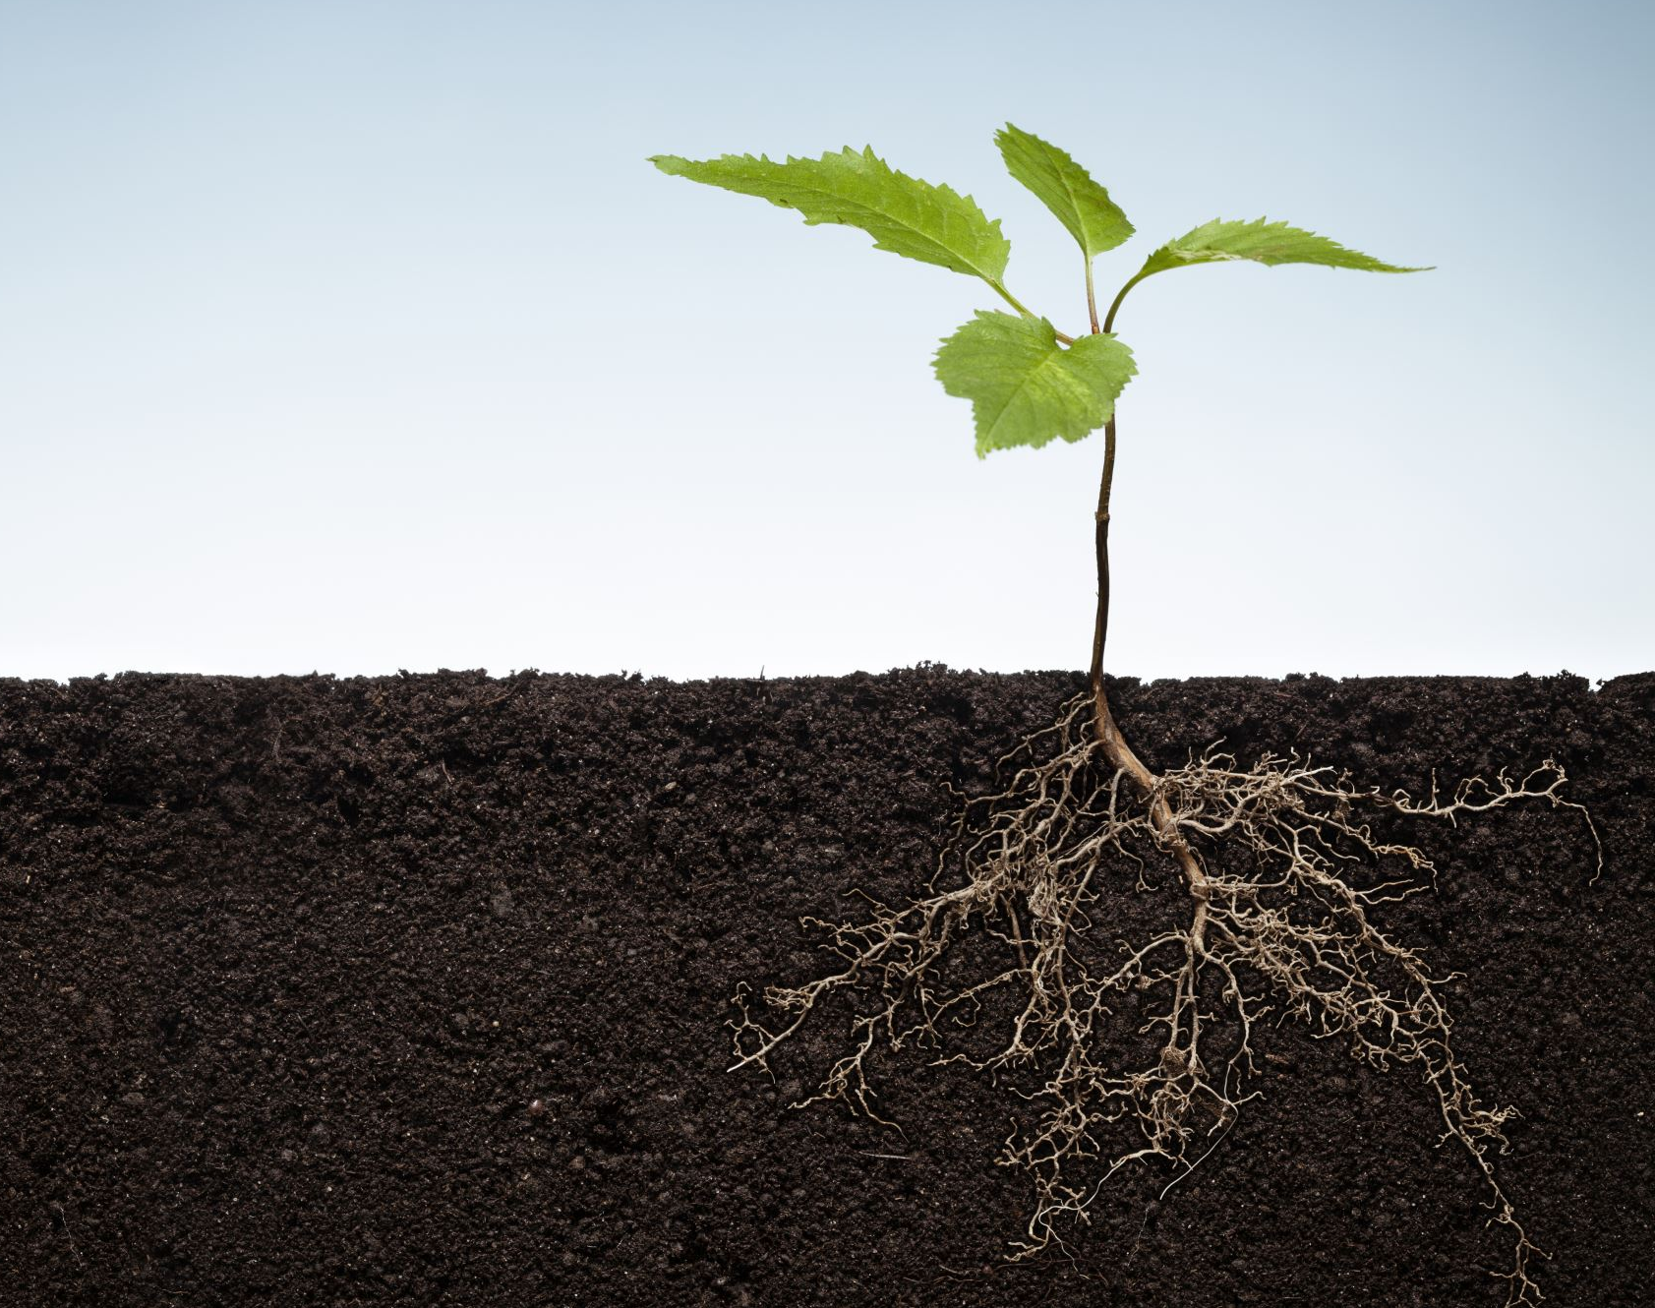
Let’s Learn About Seeds
4 Growth Stages of Plants

Slide 2
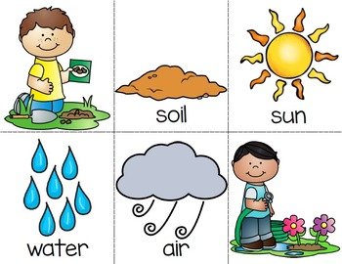
What does a seed need to grow?
Notes:
Teacher Presentation Notes
There are four important things that plants generally need to grow
Soil
Air
Water
Sun
Click through the slide 4x to display all 4 things a seed needs to grow

Slide 3

Stage 1: Seed
The plant life cycle starts with a seed
Tough outer layer called the outer coat
Inside the seed is an embryo
Notes:
Teacher Presentation Notes
Seeds have a tough outer layer called the outer coat
Inside every seed there is a tiny baby plant known as an embryo (EM-BREE-YO). The embryo has a root, shoot, and the first true leaves
Seeds will wait to go to the next stage until at least 3 needs are met: 1) water 2) good temperature 3) good location, like in soil
While the seed waits for the next stage, it is dormant, which means it is alive but inactive.

Slide 4
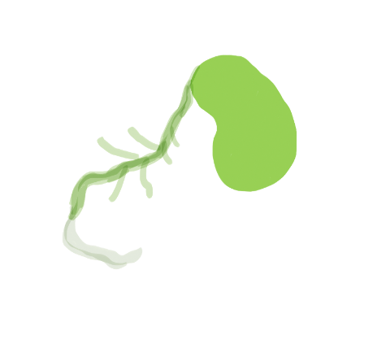
Stage 2: Germination
Seed will begin to sprout
The first root grows downward
Tiny hairs on root absorb water and minerals from soil
Notes:
Teacher Presentation Notes
When proper conditions are met for the seed, it will begin to sprout
The first root appears and begins to grow downward
On the first root, tiny hairs on the roots will appear which absorb water and minerals from the soil
The process of the sprouting seed usually after a period of dormancy is called germination

Slide 5
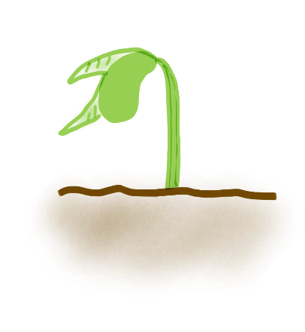
Stage 3: Seedling
Seedling is a very young plant
Starts growing towards sunlight
Remember! Seedlings need sunlight, nutrients from soil, water, and air to survive and grow
Notes:
Teacher Presentation Notes
The next step is a seedling = a very young plant that grows after germination
The seedling will start growing towards the sunlight
Remember the first slide and what the Park Ranger said during the Virtual Field Trip? Plants need sunlight, nutrients from soil, water, and air to survive and grow
Big Word = Photosynthesis = Helps the seedling grow into a mature plant

Slide 6
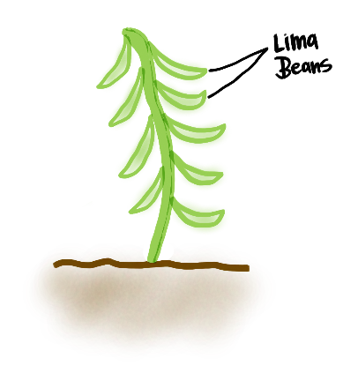
Stage 4: Adult Plant
Mature or adult plants can grow flowers or fruits
Adult plants have:
  Roots
  Stem
  Flowers or Fruits
Adult plants are bigger and have more parts than a seedling
Notes:
Teacher Presentation Notes
When a plant becomes mature (or an adult plant) it can start to grow flowers (in flowering plants) and flowers produce seeds
A mature plant have leaves, roots, stem, flower, and fruits (can produce seeds too)
Flowers are the reproductive part of a plant which makes seeds that, in turn, make new plants!
There are different parts of a flower, for example, petals, sepals, stamen, pistil, etc.
Optional: Parts of a Flower Link Part of a Flower - Fun Facts About Flowers (smartclass4kids.com)

Slide 7
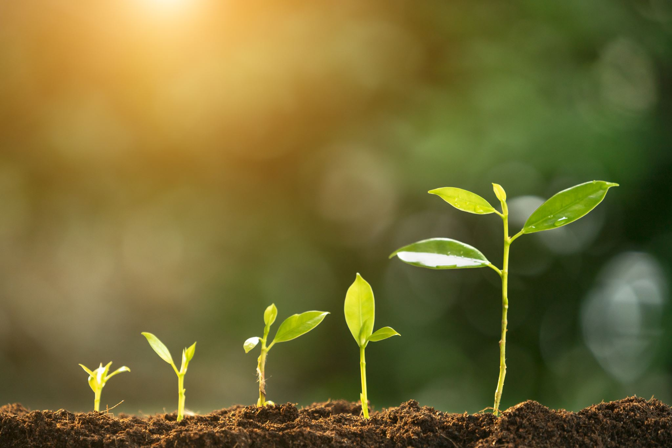
Let’s Practice!
Plant Growth Stages Activity
Materials
Stack of plant growth stages of a lima bean NOT in order
1 Blank paper
Coloring tools
Glue or tape
Directions
Rearrange the growth stages of a plant in the order you think is correct. Don’t worry we’ll discuss the correct answer as a group in a few minutes!
After the group discussion, glue or tape the stages in the correct order onto the blank paper.
Next step: In the blank space around the stages, draw and color what these plant stages need to survive and grow.
Hint: There’s 4 things . . .
Notes:
Teacher Directions: Cut out stages of plant growth. Prior to handing out squares to students, shuffle cards, then paper clip together in 1 stack. This activity corresponds with the Student Directions located on the last side (“Let’s Practice”) of the Let’s Learn About Seeds: 4 Growth Stages of Plants PowerPoint.
Student materials needed: Blank paper, coloring tools, glue or tape
Note: This activity can be done during or after the Let’s Learn About Seeds Virtual Program. Let the Park Ranger know your preference. Please have materials ready prior to start of Virtual Program if you would like the Park Ranger to guide this activity.
Teacher Presentation Notes / Script
It’s your turn to show your plant skills! In this next activity, you will demonstrate you listening and learning skills by rearranging the growth stages cards in the correct order.
Don’t worry! We’ll have a group discussion after everyone takes their first guess. Give students a few minutes to make their first guesses.
Inquiry questions: What is the order that you created? What hints (words/picture) make you think this stage goes 1st 2nd 3rd or 4th? What are some differences that you see in each stage?
Correct answer on Slide 8: Seed > Germination > Seedling > Adult Plant
Take the next couple of minutes to glue or tape your plant growth stage cards in order on your blank sheet of paper.
The next part of this activity you will need to use your thinking skills. Do you remember the what are important things for plants to survive and grow?
Hint! There are 4 things. Give students a few minutes to “tap their brain” and think about what 4 things are needed for plants to survive and grow.
Correct answer on Slide 9: Soil, air, water, and sun
In the blank space around the stages, draw and color what these plant stages need to survive and grow.
Answers for everything are on the next two slides.

Slide 8
4 Growth Stages of Plants
1. Seed
2. Germination
3. Seedling
4. Adult Plant

Slide 9
What does a seed need to grow?

